Slide 1

Less thinking and faster development
Advanced Coding Course – Week 5

Slide 2

What is a UI Framework?
Objective
By the end of this lesson you will understand what is a UI Framework and how to use them for rapid development.
ui frameworks

Slide 3
Agenda
What is a UI Framework
How to find the right one for your project
Rapid development approach
Exercise
Questions
Assignment
ui frameworks

Slide 4




What is a UI Framework
UI stands for User Interface
Framework is meant to mean that it offers prebuilt APIs that are well documented
Together, a UI Framework is a menu of HTML, CSS and Javascript components that are ready to be added into your project for use
ui frameworks
Notes:
Benefits of using UI Frameworks: Rapid Development, well documented, support from developer community, browser compatibility

Slide 5
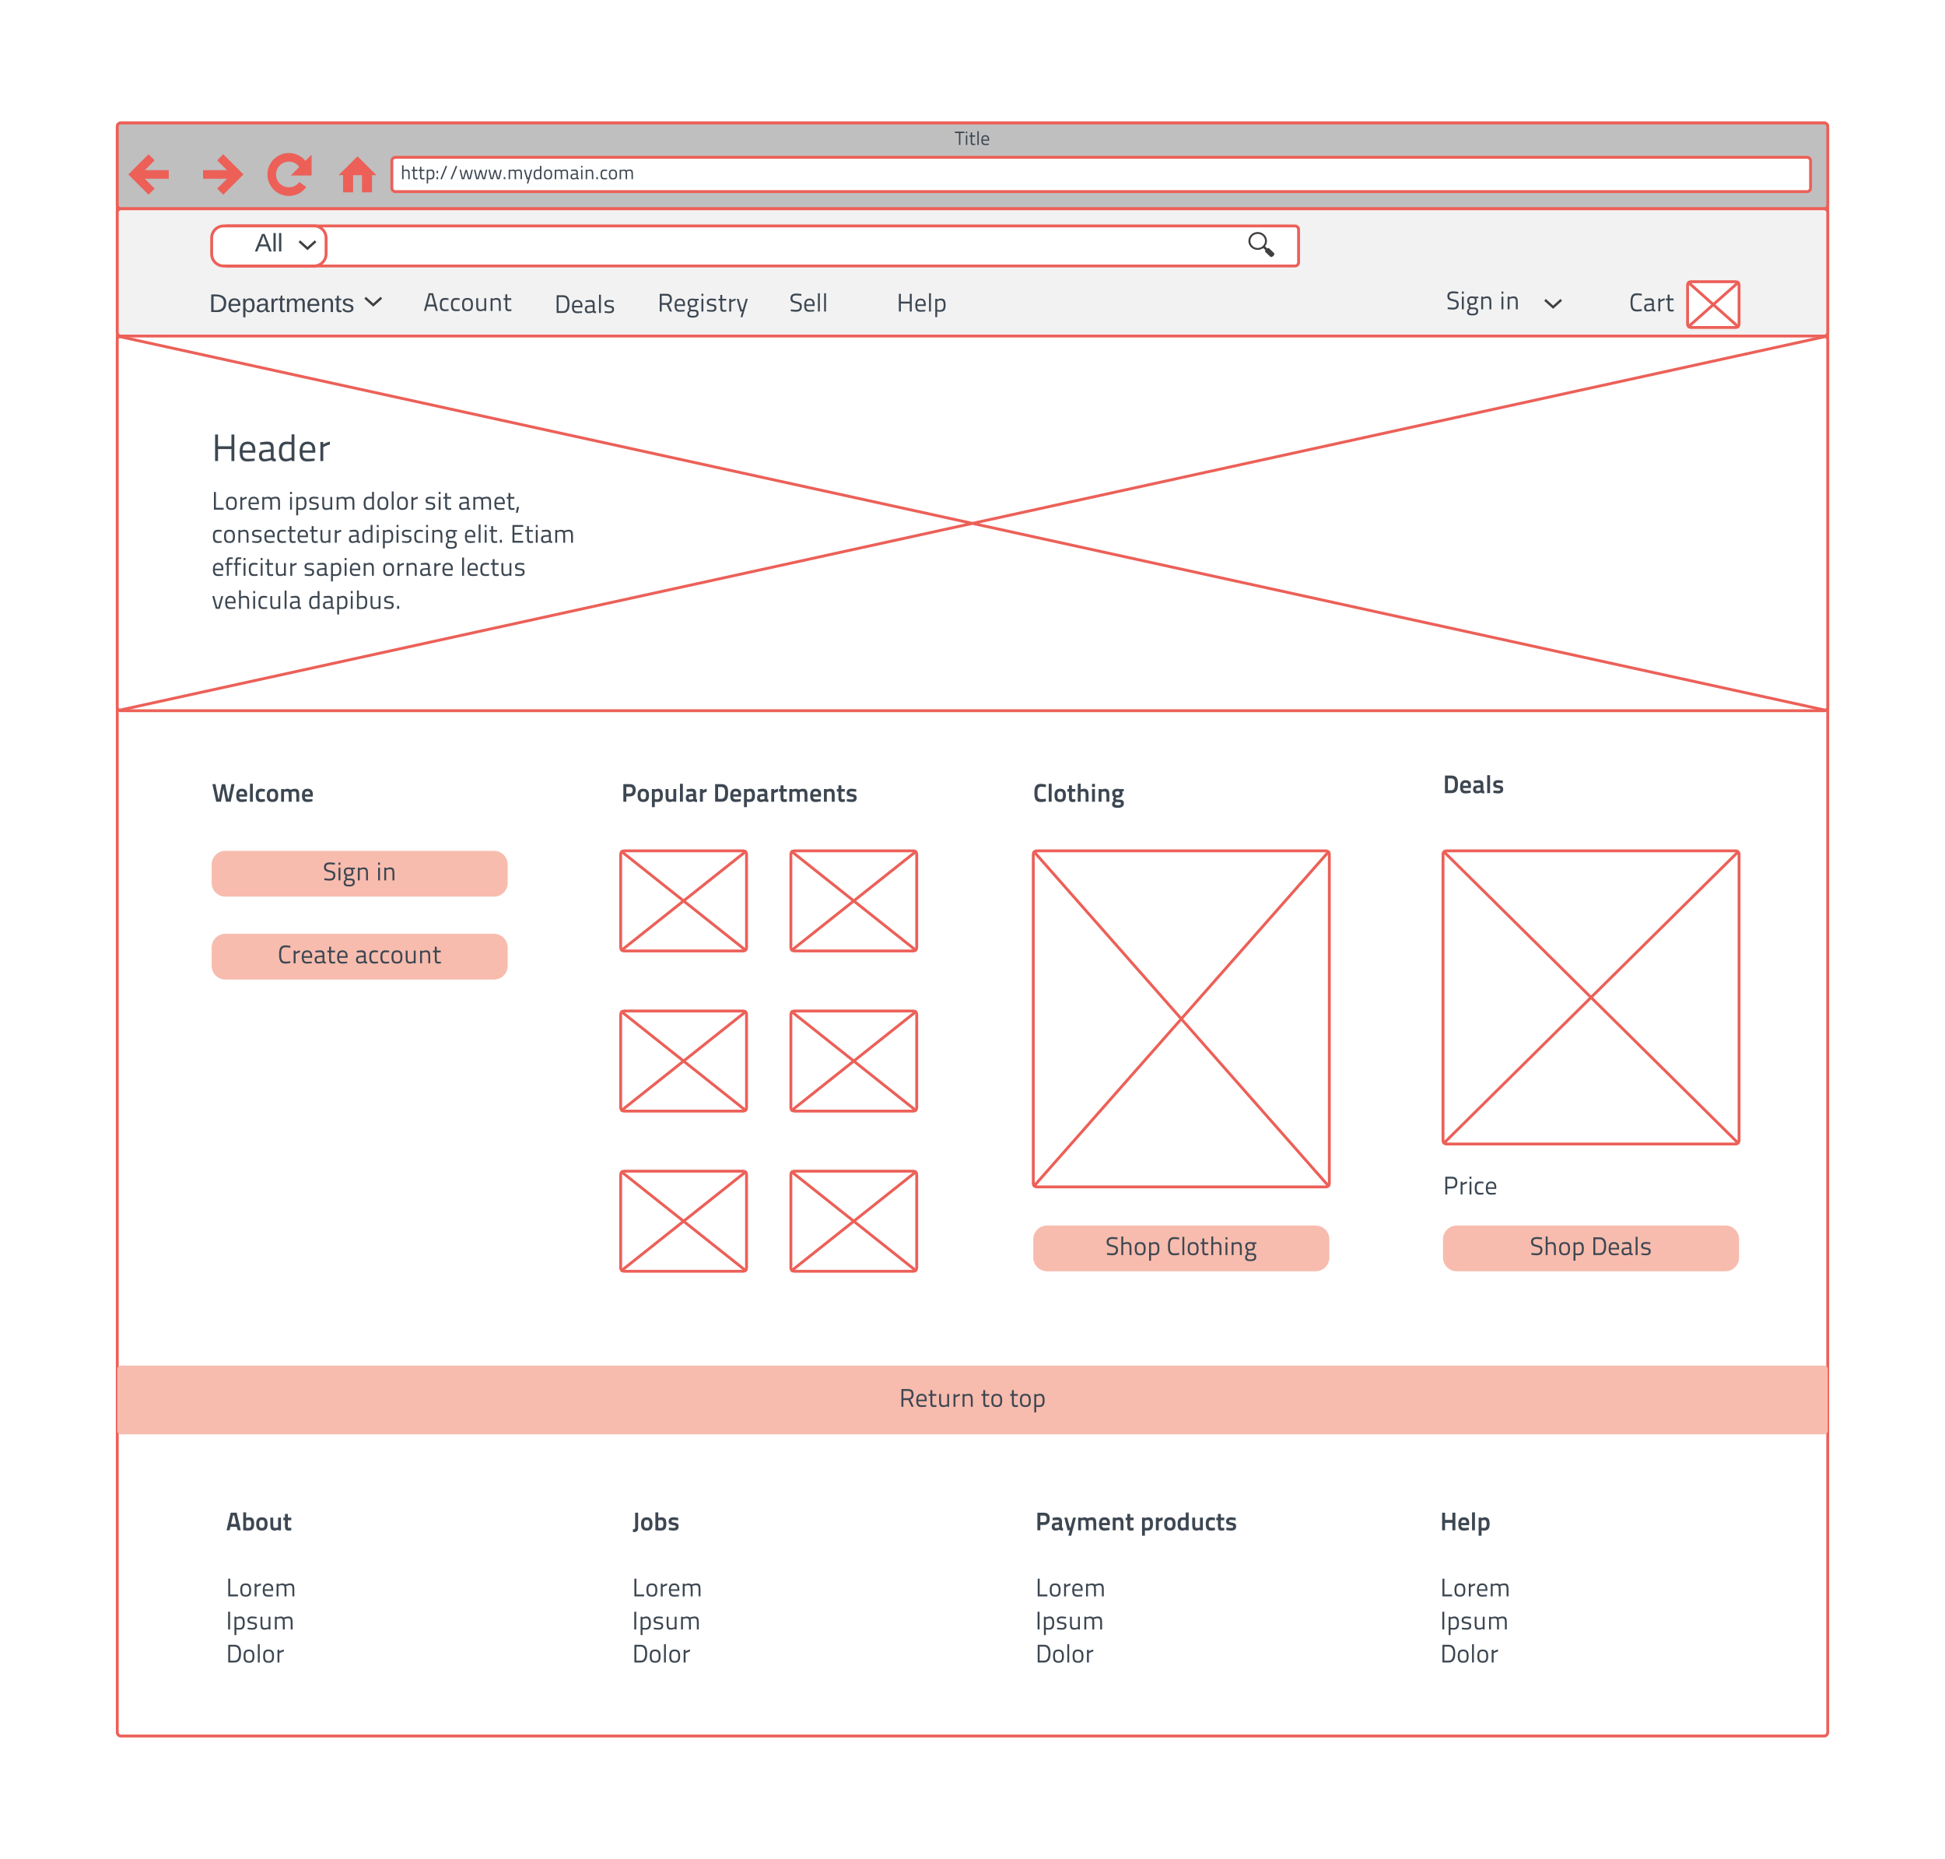
How to find the right one for your project
Two approaches:
Wireframe first then find a framework that has most of your needs
Choose a framework and start wireframing in the browser
How to check if the framework is right for you
Ask what kind of browser support do you need
Is it well documented
Google questions you might have to see if other people are talking about that framework
ui frameworks

Slide 6
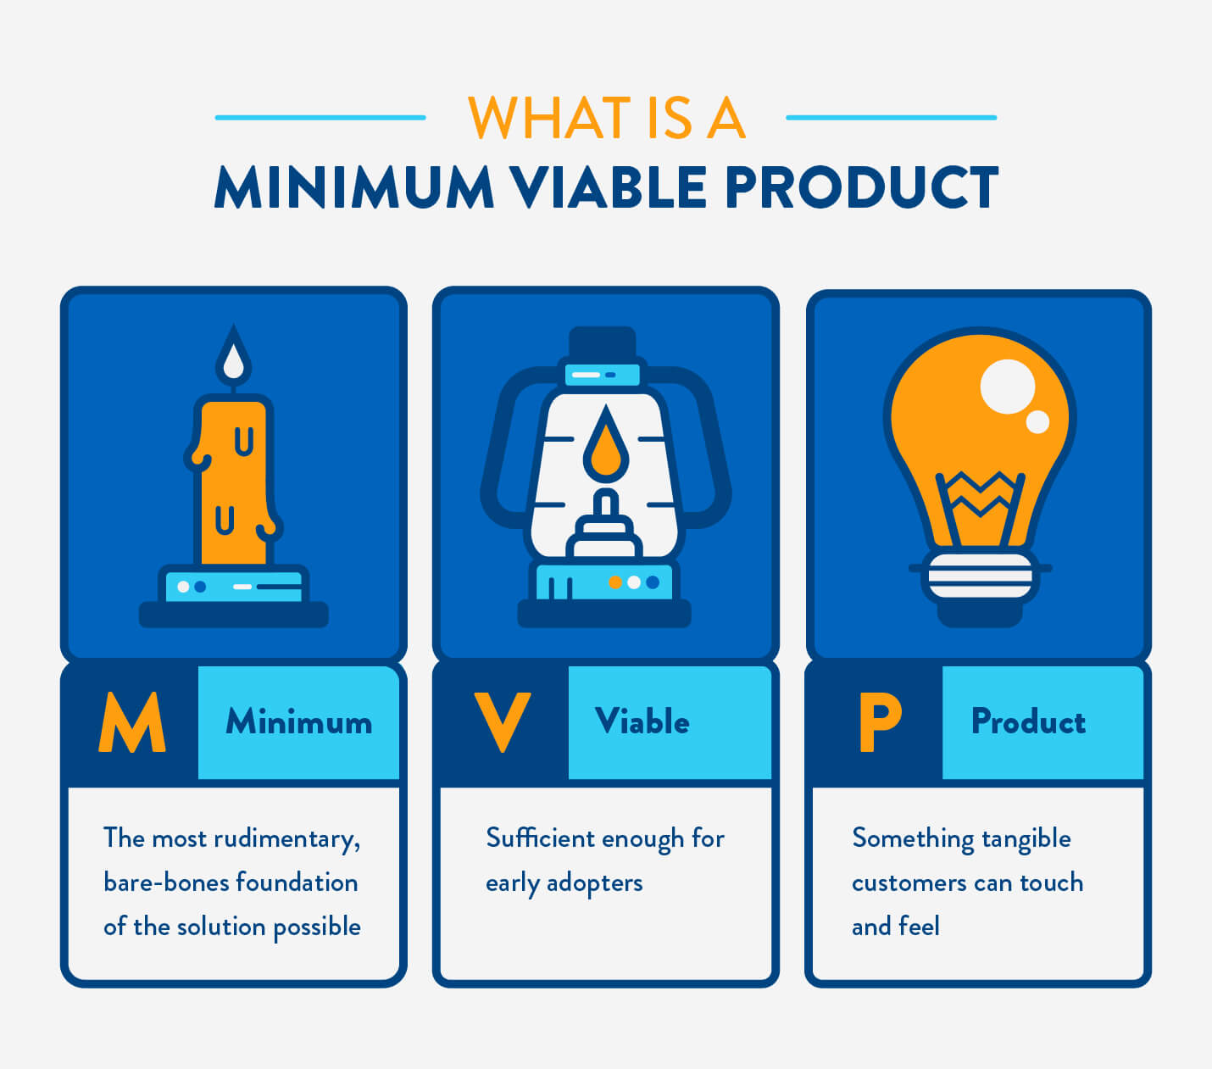
Rapid development approach
Determine minimum viable product (MVP)
Setup project
Install UI framework
Build UI with framework
Add functionality
Test your MVP with someone else
ui frameworks
Notes:
Rules:
No custom UI

Slide 7
Router Exercise – Part 1
Follow These Steps
Open Terminal on your computer
In Terminal enter cd Desktop
In Terminal enter vue create uiframeworkproject
Select Manually select features
Select Router from the menu with the spacebar and press Enter
Select no for history mode
Choose the default settings that are already selected
After the project is done being created enter the command cd uiframeworkproject
In Terminal enter npm run serve and open a browser and go to http://localhost:8080/
ui frameworks

Slide 8
Router Exercise – Part 2
Follow These Steps
Stop your server (Ctrl + C)
Go to https://vuetifyjs.com/en/getting-started/quick-start
In Terminal run the command vue add vuetify
Choose the default setup when prompted
After it is installed run npm run serve in terminal and open browser and enter http://localhost:8080
Now use Vuetify’s documentation to find out how to change the color of the app bar to deep-orange, or another color you want, in the App.vue file
Replace the content of HelloWorld with a carousel with 3 slides
ui frameworks

Slide 9
Conclusion
Objective
By the end of this lesson you will understand what is a UI Framework and how to use them for rapid development.
vuejs routers

Slide 10

questions

Slide 11
Assignment
Final Objective
Create a navigation drawer and add links to Home, About, Contact, and Favorites in your project using Vuetify. Fill those views with the content from your last homework.
Create a word document with the following content:
Brief description of yourself and what you like to do
Your contact information
List of any art, projects or exercises you created
Resources
https://vuetifyjs.com/en/getting-started/quick-start
what is vuejs

